Slide 1
The Endocrine Glands
The endocrine or ductless glands are those that deliver their secretory products (hormone) into the blood , lymph or tissue fluid , which transports them to the target organs . The function of each gland or collectively , they collaborate with the nervous system in maintaining the internal environment and securing the appropriate general and specific responses to stimuli from both external and internal sources. The study of the anatomy of the glands, the production and the chemistry of the hormones, the responses of the target organs, and the complicated interplay of the various endocrine tissues with each other and with the nervous system is entitled endocrinology.

Slide 2
Three type of endocrine organ may be recognized
1- Comprises the few discrete organs of a primary endocrine nature
Hypophysis (pituitary gland )
Epiphysis (pineal gland)
Thyroid
Parathyroid
Adrenal gland .
2- Comprises the organ that combine major endocrine function like pancreas , testis , ovaries and placenta.
3- Comprise unobstrusive(غير بارز ) endocrine component of organ with a quite different primary function; like brain , kidney , liver , thymus and heart .

Slide 3
1- Hypophysis (pituitary gland )
The hypophysis or pituitary gland is sometimes described as the master gland because it produces certain hormones that directly influence the activities of other endocrine glands. However the gland itself controlled by the hypothalamus. This small but vital region of the brain lies just above the pituitary and produces a range of hormones that regulates the secretion of many others glands. The pituitary is a dark ellipsoidal body, it suspended below the hypothalamus by a narrow stalk . The optic chiasm is directly rostral to the hypophysis .

Slide 4
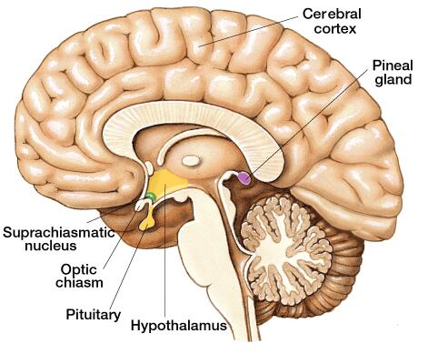

Slide 5
The pituitary has two portions: the posterior pituitary (neurohypophysis) and the anterior pituitary (adrenohypophysis).
The anterior pituitary gland secretes hormones that regulate a wide range of activities in the body. These include:
1. Growth hormone that stimulates body growth.
2. Prolactin that initiates milk production.
3. Follicle stimulating hormone (FSH) that stimulates the development of the follicles of the ovaries. These then secrete oestrogen .
4. melanocyte stimulating hormone (MSH) that causes darkening of skin by producing melanin
5. lutenizing hormone (LH) that stimulates ovulation and production of progesterone and testosterone
The posterior pituitary gland
1. Antidiuretic Hormone (ADH), regulates water loss and increases blood pressure
2. Oxytocin, milk "let down"

Slide 6
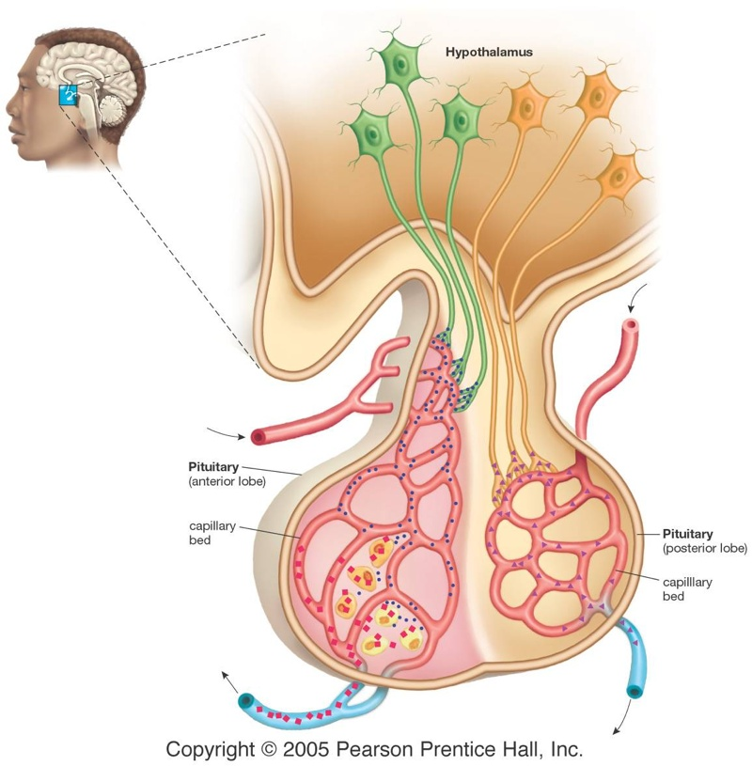

Slide 7
The adenohypophysis and neurohypophysis are separately vascularized. The neurohypophysis is supplied by small branches from the internal carotid artery and the arterial circle (of Willis) of the brain. The adenohypophysis is supplied indirectly; rostral hypophysial

Slide 8
2 - The epiphysis(pineal gland ) :
The pineal gland is an unpaired organ located immediately behind the thalamus. It is part of diencephalon and lies dorsally to it and attached to it via short peduncle, between the cerebral hemispheres and the cerebellum . It is innervated by the postganglionic sympathetic fibres from the cranial cervical ganglion. The pineal gland secretes melatonin in response sleep and the seasonal variations in reproductive behaviour.

Slide 9
3- Thyroid gland
It lies on the trachea directly behind the and sometimes overlapping, the larynx.. It forms varies greatly, in dog and cat the gland consist of separate masses that are occasionally connected by an isthmus, in horse paired lobes are widely separated insubstantial (لاقيمة ) isthmus . In small ruminants the isthmus is inconstant but when present is a mere connective tissue strand.

Slide 10
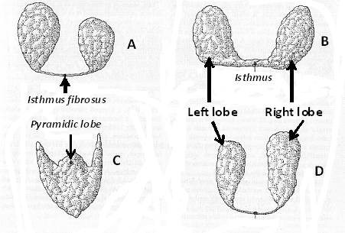
Figure 1.2.: Thyroid gland of domestic animals; A) horse, B) cattle, C) pig , D) dog

Slide 11
In cattle the lobes are connected by a wide isthmus of parenchymal tissue . In pig and human has a more compact form and exhibits a relatively large median lobe in addition to lateral lobe . The mature gland is enclosed within a connective tissue capsule that is loosely attached to neighboring organs. Its substance, generally brick-red, obtains a rather granular texture from the many enclosed follicles of which it is composed.

Slide 12
In some species (e.g., cattle) these give the intact organ an irregular appearance, but in others (e.g., dog) the surface is quite smooth. The size of the thyroid gland varies greatly, depending to a large extent on the iodine content of the diet; when this content is deficient, enlargement (goiter) may develop.
The thyroid hormone , concerned with metabolism and growth .

Slide 13
4- Parathyroid
Parathyroid glands are salmon-coloured and distinct from the thyroid glands. Usually four parathyroid glands , small epithelial bodies located close to or embedded within the much larger thyroid . In the dog , cat and small ruminants the parathyroid become recessed or embedded within the substance of thyroid gland . They can be identified by their pale color, which contrasts with the thyroid tissue. In cattle and horse are usually located closed to the thyroid gland .
The parathyroid hormones plays a vital role in the regulation of of various aspect of calcium metabolism and absorption from gut .

Slide 14
5- The adrenal gland : The adrenal glands are paired organs located against the roof of the abdomen near the thoracolumbar junction, in a position immediately prior to the kidneys and close to their cranial poles.
Although generally elongated, the glands are often asymmetrical and quite irregular, being molded on neighboring vessels . It is difficult to specify their size because this appears to be influenced by several factors; they are relatively larger in wild than in related domestic forms, in juvenile than in adult individuals, and in pregnant and lactating females than in those reproductively inactive. Those of a medium-sized dog commonly measure about 2.5 × 1 × 0.5 cm.

Slide 15
There are two parts to this endocrine gland, an outer cortex and an inner medulla .The cortex covered by a fibrous capsule , is yellowish and radially striated ; the much darker medulla has amore uniform appearance. The adrenal cortex and medulla produces several hormones

Slide 16
Other endocrine glands
OTHER ENDOCRINE TISSUES
The most familiar example is provided by the endocrine component of the pancreas, the pancreatic islets, also known as the islets
of Langerhans. The endocrine component comprises many hundred (or thousand) islets of varying size unevenly distributed among the predominant exocrine tissue. The islets are not normally visible to the naked eye .

